Slide 1
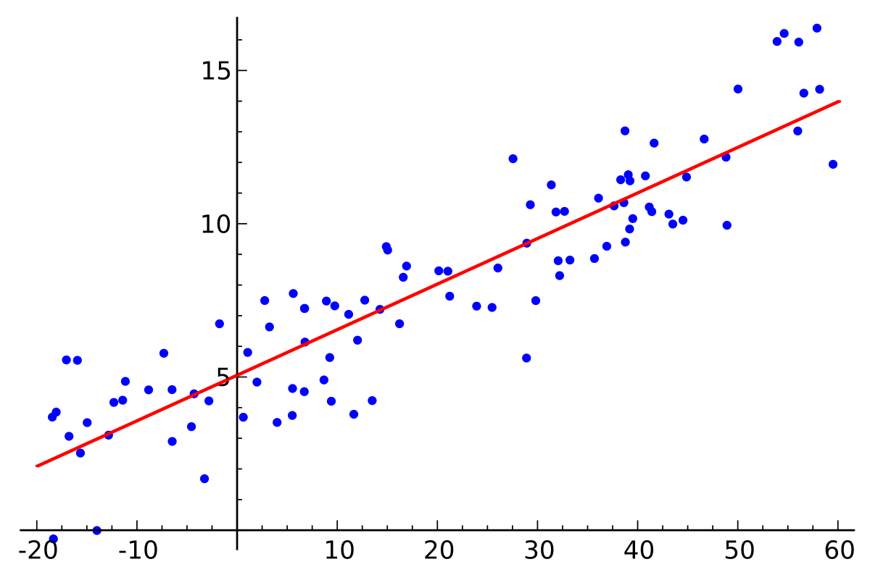
Linear Regression
ENGR 96A: Python and Machine Learning

Slide 2
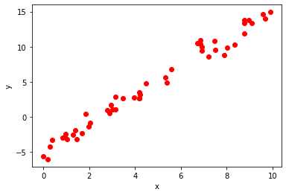
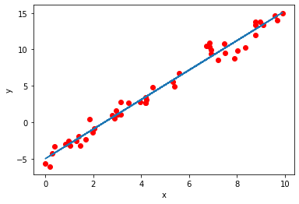
What is Linear Regression?
Imagine we have a cluster of data points
We want to find the line that best fits the data
Linear Regression!

Slide 3

Representing a Line
We can represent a line as:
where X is our input data, Y^ is our estimate of Y, and 𝛽^₁ and 𝛽^₂ are our model parameters (or weights)

Slide 4
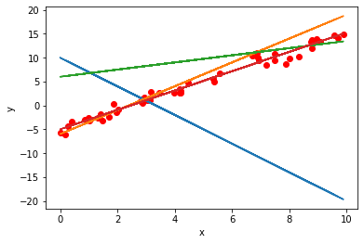
Different Possible Lines
Here are a number of lines overlaid on our cluster of data:
But how do we measure how good of a fit each line is?

Slide 5
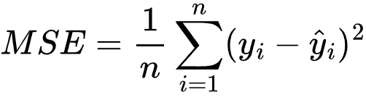
Calculating Line Error
This is the mean squared error
Why might it be a good measure of how close our line is to our points?

Slide 6
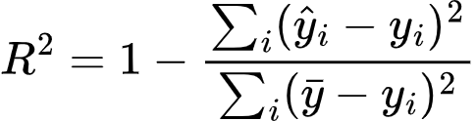
Calculating Fit
We can also use the coefficient of determination to see how linearly related the independent and dependent variables are

Slide 7
Optimization
So now we have a way to represent lines and a way to measure how good those lines are
Next we need a way to optimize our parameters to find the best fit of the data
There are a few methods we can employ:
Brute force
Analytical
Gradient descent

Slide 8
Brute Force
We could try every single possible combination of 𝛽₁ and 𝛽₀ and see which one gives us the lowest MSE.
Advantages:
Gets the model with the lowest MSE
Disadvantages:
Could potentially take infinitely long
Inefficient

Slide 9
Exact Solution
We could solve this like a system of equations
Take the partial derivatives of L with respect to 𝛽₁ and 𝛽0, and set them to zero
Advantages:
Get the exact solution
Once we have the formulas the calculation is easy
Disadvantages:
Won’t work on every problem

Slide 10
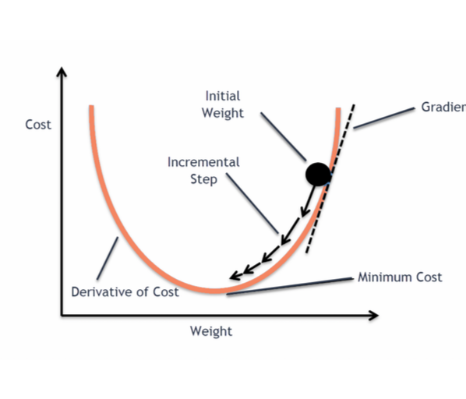
Gradient
If you have taken multivariable calculus, the gradient of a function points in the direction of steepest descent
If you haven’t, it’s the gradient is basically the slope of a multivariable function
One way of minimizing the MSE (or error function) is to move in the direction of the gradient at every step of the function

Slide 11
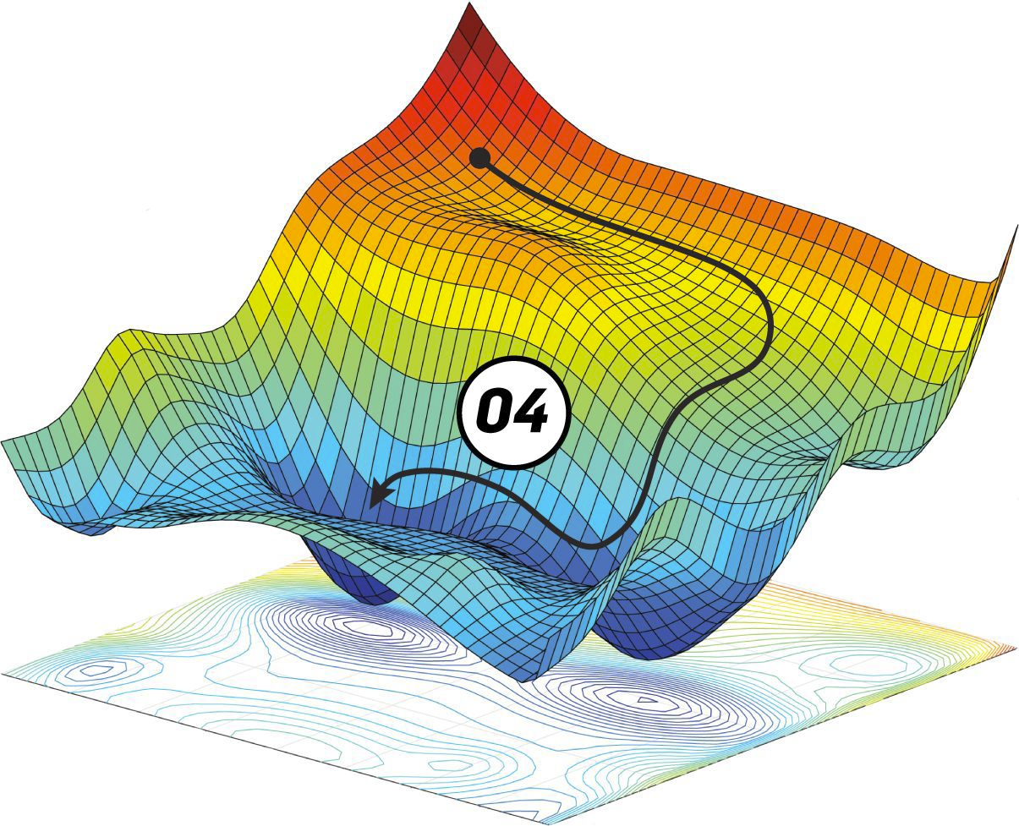
Gradient Descent
The steps to gradient descent include:
Inputting data into the model and getting the MSE
Calculating the partial derivative of the MSE with respect to each model parameter (slope and y-intercept for linear regression)
Adding these values to each model parameter
Repeat
Using this approach, we hope to find parameters that give us a minimum of the loss function

Slide 12
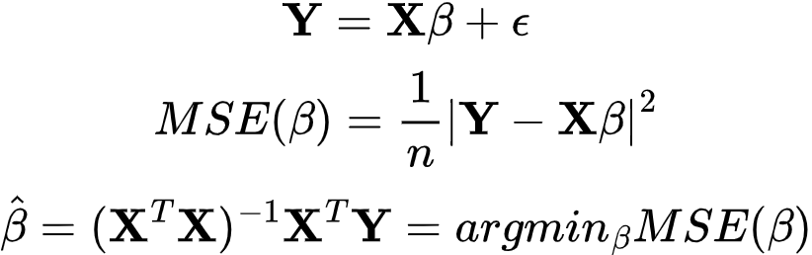
Multilinear Regression
What if we had multiple independent variables with one dependent variable? We could model it like this:
We could represent this extended model with matrices and these equations:

Slide 13
Polynomial Regression
We can also use this model to fit polynomial lines:
Instead of separate x’s for each datapoint, we have the same x with different 𝛽’s

Slide 14
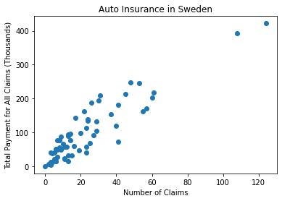
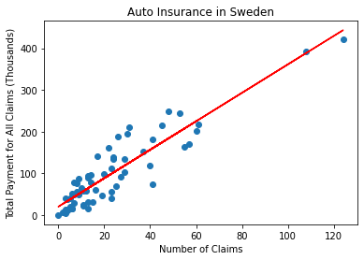
How to use Linear Regression: NumPy’s polyfit
polyfit
x - independent variable
y - dependent variable
deg - degree of polynomial you would like to fit
1 for linear

Slide 15
Summary
We learned:
How to represent lines
How to calculate the degree to which our line fits our data
How to optimize the parameters of our line to get a line of the best fit
Brute force
Analytical
Gradient Descent
More advanced versions of this technique applied to:
More dimensions
Higher order polynomials
How to use linear and polynomial regression in NumPy using polyfit

